Slide 1

Introduction to Java
Session 1

Slide 2
Objectives
Explain the history of Java
Explain Java in brief
List the types of Java programs
List Java Capabilities
Differentiate between applets and applications
Explain the Java Virtual Machine (JVM)
List the features of some IDEs
Examine the JDK and tools under it
Analyze future trends and technologies

Slide 3


Introduction to Java
Introduced in 1995 by Sun Microsystems
Its objective was to develop a software for embedding in consumer electronic devices.
Initially called ‘Oak’
Internet users had problems of portability and platform independence.
Java being secure, portable, and platform independent was found to be capable of addressing large scale problems across the Internet.

Slide 4

What is Java?
An object-oriented programming language
A cross platform language
It is used to create stand-alone applications, net based programs and consumer devices programs.
  Example : cellular phones, palm pilots

Slide 5



Java and the Internet
Programs on the net are either static or dynamic.
Applets helps to develop dynamic programs.
Applets run on a Java enabled web browser.
Applets can respond to user input and actions.

Slide 6


Security issues
An Applet has to be downloaded on the user’s system before it can work.
This can be a potential risk for the user’s system.
Hence, applets are restricted from accessing all areas of the disk.

Slide 7
Security issues Contd…
The control is exercised by the
Java Virtual Machine (JVM)
  JVM generates byte codes as a result of compilation
  Byte codes cannot be executed without the JVM

Slide 8
Features in Java2
Swing: new set of classes and interfaces used to create an advanced GUI
Drag and Drop: interactively transfers information across different applications. Also transfers information interactively from one part of a program’s interface to another.

Slide 9
Features in Java2 Contd…
Java 2D API: set of classes for advanced 2D graphics and imaging
Java Sound: totally new set of features pertaining to Java’s audio features
RMI: Remote Method Invocation allows applications to call objects located at remote sites and communicate with them

Slide 10
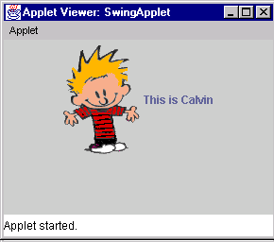
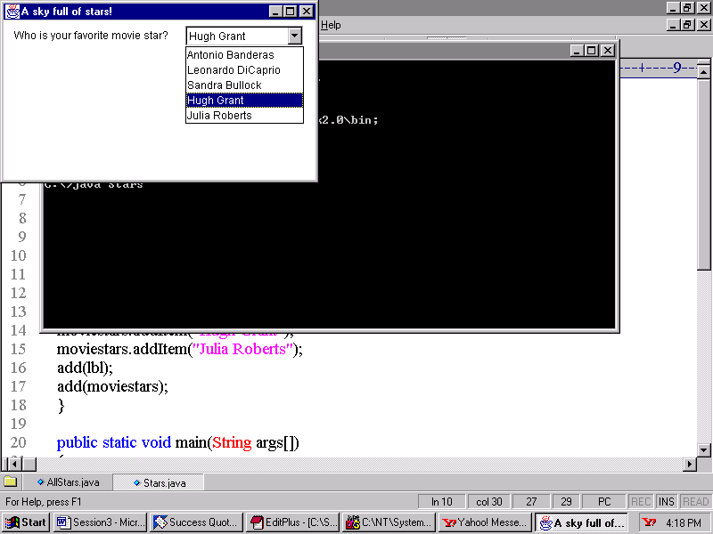
Types of Java Programs
Applets
  Programs created specially to work with the Internet
Displays an image
GUI to accept user input

Slide 11
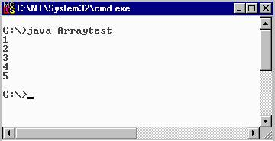
Types of Java Programs Contd…
Console applications
  Java programs that run from a command prompt and do not display any GUI screen

Slide 12
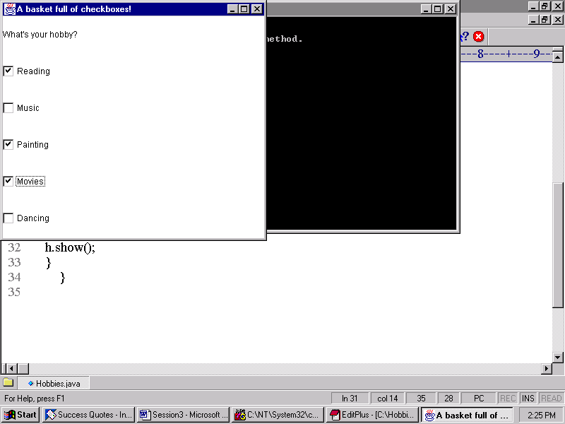
Types of Java Programs
Contd…
  GUI Applications: Java programs that run stand-alone and accept user input through a GUI based screen.

Slide 13
Types of Java Programs Contd…
Servlets
  Suitable for web based n-tier application development
  Client sends request which is processed by the server
  The server side APIs extend capabilities of standard APIs and are known as Servlets
  Also called server side applets
  Example – HTML form processing, processing databases and performing server side transactions

Slide 14
Types of Java Programs Contd…
Packages
  Class libraries in Java
  Programmers can create their own packages or use the built-in packages
    java.awt, java.io and java.applet are some examples
Database applications
  Uses JDBC API for database connectivity
  Programs can be either applets or application

Slide 15
What can we do with Java?
Create a wide variety of applications from a simple computation program to complex distributed application
One can develop:
  Colorful scrolling banner for web pages
  Interactive quizzes
  A program that plays audio, displays a banner and animates images at the same time
  Interactive games that can run as stand alone or be deployed on the web

Slide 16
Difference between
Applets and Applications
Applications
Applets
Do not need a browser to execute
These run within JVM
Executed in a java compatible web browser
Applets load and run on a Java-enabled web browser

Slide 17
Difference between Applets and Applications Contd…
Applications
Applets
Manages its own flow of execution
No restrictions about reading or writing from/to the local file system
Flow of execution is partly managed by the browser context
Cannot read/write from/to the local file system

Slide 18
Similarities in
Applets and Applications
Both need to use the standard Java class libraries
Both can use the Abstract Windowing Toolkit (AWT)

Slide 19
Java Virtual Machine (JVM)
Has an interpreter component that enables communication between Java byte code and a computer’s operating system
Java code can run on any platform by using JVM
JVM normally reads and executes Java statements one at a time
JVM is responsible for platform independence and small size compiled code
Recognizes only a particular binary format called a class file

Slide 20
Visual Development Tools
Helps in quick and efficient development of Java applications and applets
Simplifies the software development process
Includes class browser for viewing and navigating through the class hierarchy
Includes a source code editor that helps code programs

Slide 21
Some Visual Development Tools
Visual Age for Java from IBM
  Works with existing databases, applications and transactions
Borland Jbuilder from Borland/Inprise
  Includes an integrated editor, debugger, compiler, visual designer, wizards and sample applications
Forte for Java, Community Edition from Sun Microsystems
  Integrated visual design, editing, compilation and debugging capabilities to create applets and applications

Slide 22
Java Development Kit (JDK)
Contains the software and tools needed to compile, debug and execute applets and applications
A set of command line tools
Three major releases are:
  Java 1.0 – first release
  Java 1.1 – 1997 release
  Java 1.4.2 – latest release
Freely available at Sun’s official website

Slide 23
Tools under JDK
javac: compiler used to compile Java source code
  Syntax: javac [option] source
  Source files ends with an extension of .java
  Options include:
    -classpath
    -d
    -g
    -o
    -verbose

Slide 24
Tools under JDK Contd…
java: interpreter used to execute Java byte codes
  java [option] classname [arguments]
  Options can include
    -classpath
    -Dname name
    -help
    -v or –verbose
    -X

Slide 25
Tools under JDK Contd…
appletviewer: Used to view and test applets
  Syntax: appletviewer [options] url
javadoc: This is the Java documentation tool
  Generates detailed documentation in HTML form for any .java source code or package

Slide 26
New Features of Java 1.4.2
Improved
  Compiling Speeds
  Divisions of integers and floating point numbers
Provides support to IE and Netscape for redirecting URLs
New I/O Class added
Few bugs have been removed in AWT

Slide 27
New Features of Java 1.4.2 Contd…
A new class to provide endless support for mouse wheel scrolling.
Supports the standard Microsoft Windows XP appearance as default when running on Windows XP platform.
Indeterminate progress bars have been added.
JTabbedPane displays a single, scrollable run of tabs.
A spinner is a single line input field that lets the user select a number or an object value from an ordered set.

Slide 28
Present Java Technologies
Creation and deployment of applications that can run on any operating system
Support for distributed computing in the form of features such as RMI
Database management support in the form of JDBC
Reusable software components in the form of JavaBeans

Slide 29
Present Java Technologies Contd…
Java 2 Enterprise Edition (J2EE) which includes:
Enterprise Java Beans (EJB)
Java Server Pages (JSP)
Java Servlets

Slide 30
Future trends
New products in the area of embedded technologies for consumer devices by making use of mobile computing.
Miniature devices such as Palm pilots and mobile phones are equipped with a features such as email, gaming options and many others.
They are based upon Java 2 Micro Edition (J2ME).

Slide 31
Summary
Java was introduced by Sun Microsystems in 1995.
Java is a programming language popularly used to build programs that can work on the Net.
Its primary features are that it is object-oriented and a cross platform language.
Swing, Drag and Drop, Java 2D API, Java Sound and RMI are some of the features added to the existing version of Java.
A Java applet is designed to work in a pre-defined “sandbox” only. This makes it safe to be used on the Internet.
Java bytecodes are machine language instructions understood by the Java Virtual Machine and usually generated as a result of compiling Java language source code.

Slide 32
Summary Contd…
Java programs can be divided into following categories - applets, applications, GUI applications, servlets and database applications.
Java visual development tools help to develop Java applications and applets more quickly and efficiently.
The JDK contains the software and tools needed to compile, debug and execute applets and applications written in the Java language. It’s basically a set of command-line tools.
Enhancement in Swing, AWT, a new I/O class and so on has been added in the latest version of Java 1.4.2.
The future will use a lot of Java related programs for consumer gadgets with embedded technologies.

